Slide 1
Stanley X Hackathon
System for identifying, capturing, and organizing critical knowledge (Theme 3)
Link
Vijay Balasubramaniam & Nithin Vijaykumar

Slide 2
Mission
“Our mission is to supercharge the collaboration between humans and machines.”
The Knowledge Nuggets system is designed to maximize the productivity of people in a manufacturing facility. We do this by merging certain aspects of the physical and digital worlds.

Slide 3
Target User and Problem Definition
The target user persona is someone who steps into a manufacturing facility that they haven't visited before. He/she is looking to accomplish some task or project, and needs to use the equipment available to complete their task. Being new at the site, they are immediately presented with a few challenges:
1. They are not familiar with the layout of the facility, intended purpose of each workspace and tools available at each workspace
2. They don't know where to find specific pieces of equipment, accessories and related resources needed to complete their project
3. They may not know how to use the available equipment from a functional perspective
4. They may not be familiar with how to safely operate the equipment and mitigate situations if something goes wrong

Slide 4
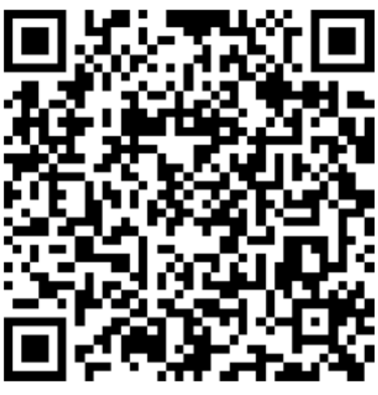

Solution Overview
The Knowledge Nuggets system is designed to capture the experience of people who already know how to be productive with the environment/tools, and pass on this knowledge to others to help them accomplish their tasks.
The system uses stickers with QR codes to uniquely identify items and associate them with the appropriate knowledge nugget. The system includes an approval process to ensure the quality of information entered.
By facilitating the easy retrieval of relevant information, the system helps the user successfully complete their intended task. Beyond the completion of the immediate task, the system also provides opportunities and incentives to gain proficiency and become certified, and thereby unlock rewards and additional access.

Slide 5
Design Goals
Use a human-centered design approach with the following goals:
Accessible - Works on any phone, tablet or computer
Simple - Provides an intuitive user experience
Incentive-driven - Provides all users with economic incentives to participate by contributing and curating high quality content
Extensible - Built using open source technologies that have robust community support and a thriving plugin ecosystem
Cost-effective - Uses serverless technologies where possible to minimize operating costs

Slide 6
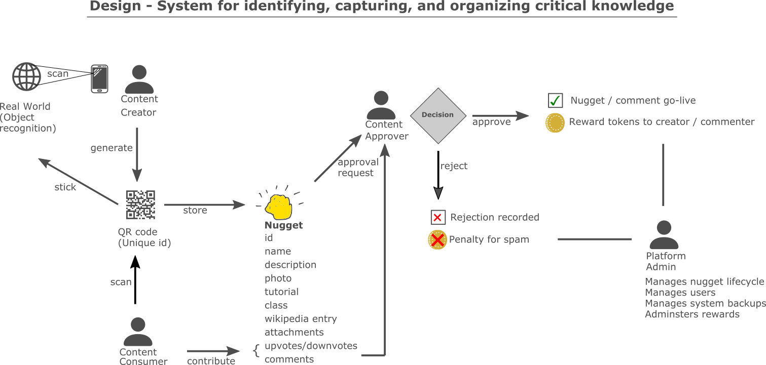

Slide 7
Capabilities
The following capabilities are included in the Minimum Viable Product (MVP) prototype
Core content management including text, video, attachments
Knowledge capture into a “nugget”, and retrieval using directory lookup and search
Physical workspace integration using QR code stuck to machines
Workspace mapping to capture spatial arrangement of equipment
User roles for production employee, supervisor, plant manager, etc.
Tie items to learning paths for career development

Slide 8
Constraints and Known Issues
Constraints
Since cost effectiveness is a design goal, the system is designed to work on free or inexpensive cloud servers, and use serverless technologies so that costs are incurred only when the system is in use
Since widespread device support is a design goal, the system is built as a web application that works on any phone, tablet or computer
Known Issues
None at this time

Slide 9
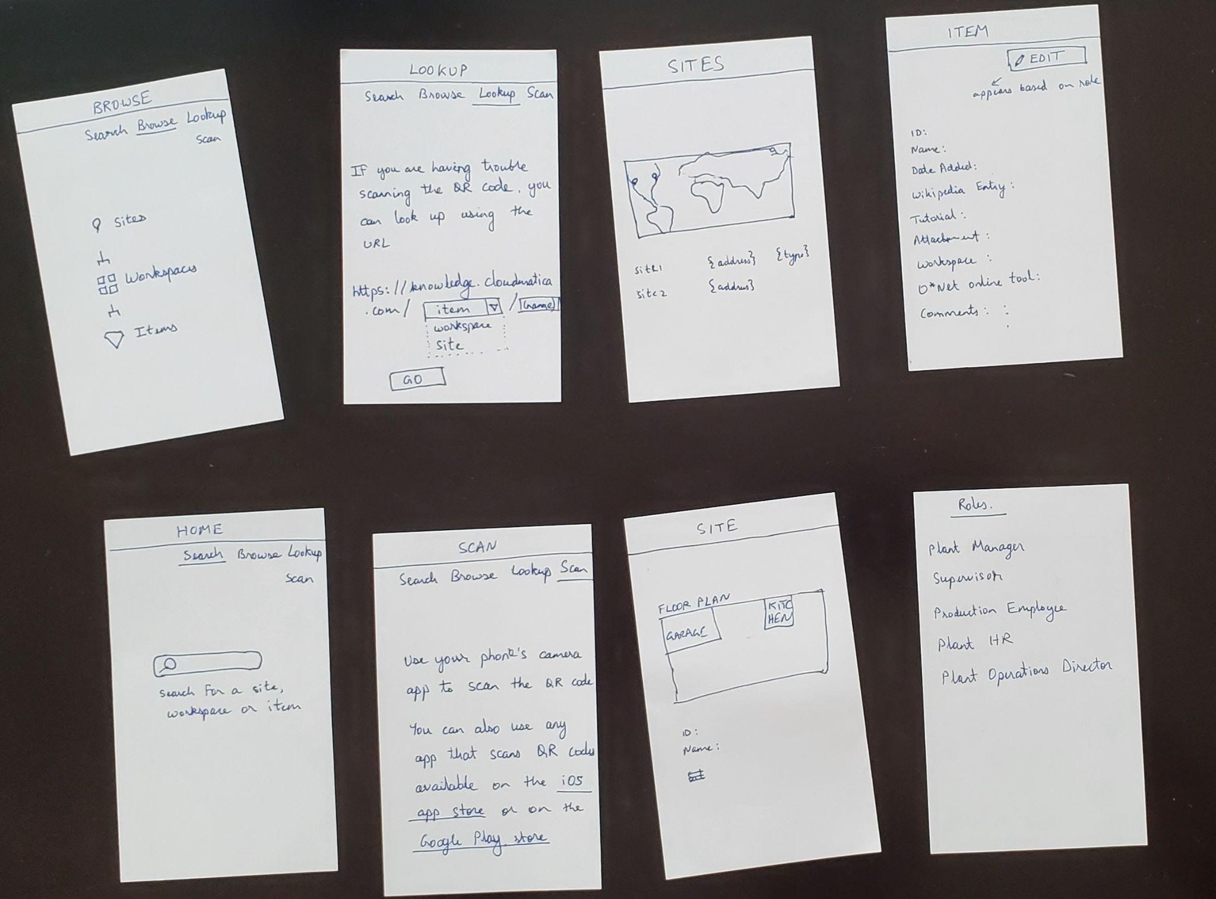
Design:
Wireframes

Slide 10

Roles
Production Employee
Supervisor
Plant Manager
Platform Admin
Plant HR
Plant Operations Director
Visitor

Slide 11
Role Mapping
Using the philosophy of “standing on the shoulders of giants”, the system builds on the robust role framework provided by Wordpress. The initial mapping is as follows, and can be customized.
Role | Wordpress Role
Production Employee | Contributor
Supervisor | Author
Plant Manager | Editor
Plant HR | Subscriber
Plant Operations Director | Subscriber
Visitor | Subscriber
Platform Admin | Administrator

Slide 12
Next Steps and Roadmap
The initial MVP prototype is just the beginning! We plan to rapidly iterate and improve the solution by getting direct feedback and inputs from employees on the production floor.
Planned Enhancements (roadmap)
Introduce support for 3D workspaces that leverage AR/VR technologies and assist the user to locate items in 3D space
Implement image recognition (AI) using Google’s Cloud Vision APIs, and by training custom models to recognize items on the factory floor
Build a reward system (gamification) to encourage positive contribution and discourage spam
Develop enhanced learning paths tied to job roles across multiple manufacturing/distribution facilities
Implement credentials that automatically unlock access to machines that require safety training

Slide 13
Appendix - Screenshots

Slide 14
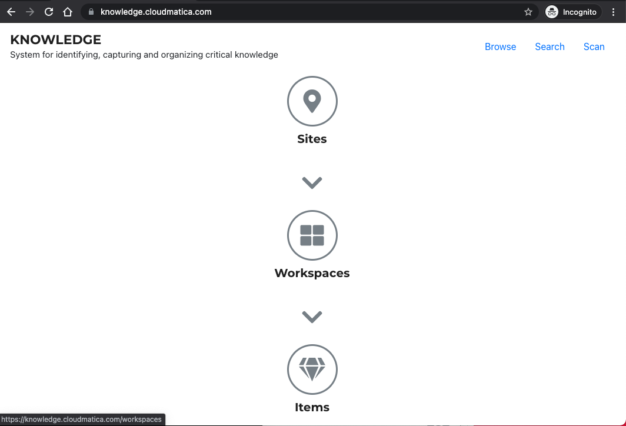

Slide 15
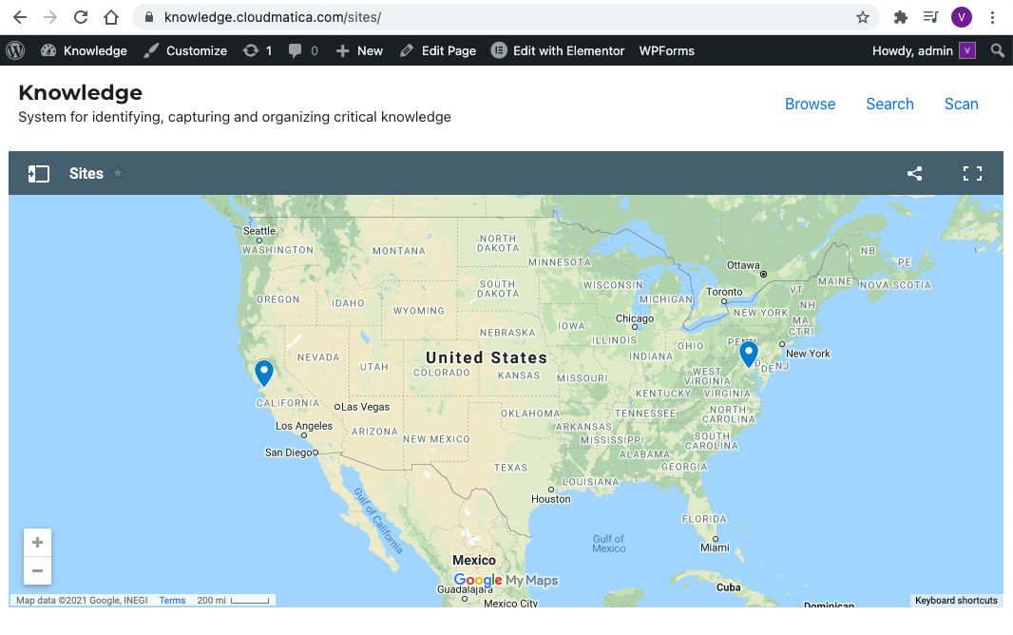

Slide 16
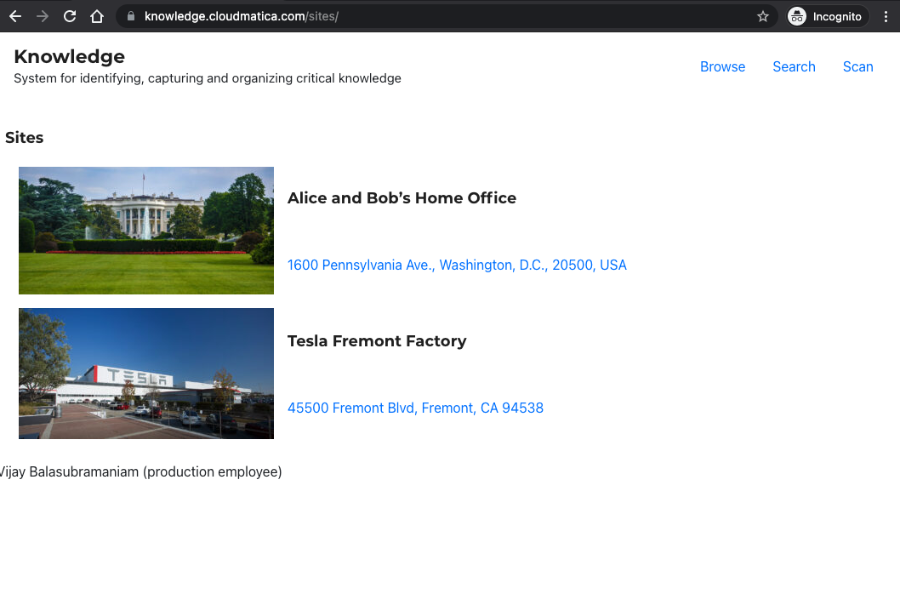

Slide 17
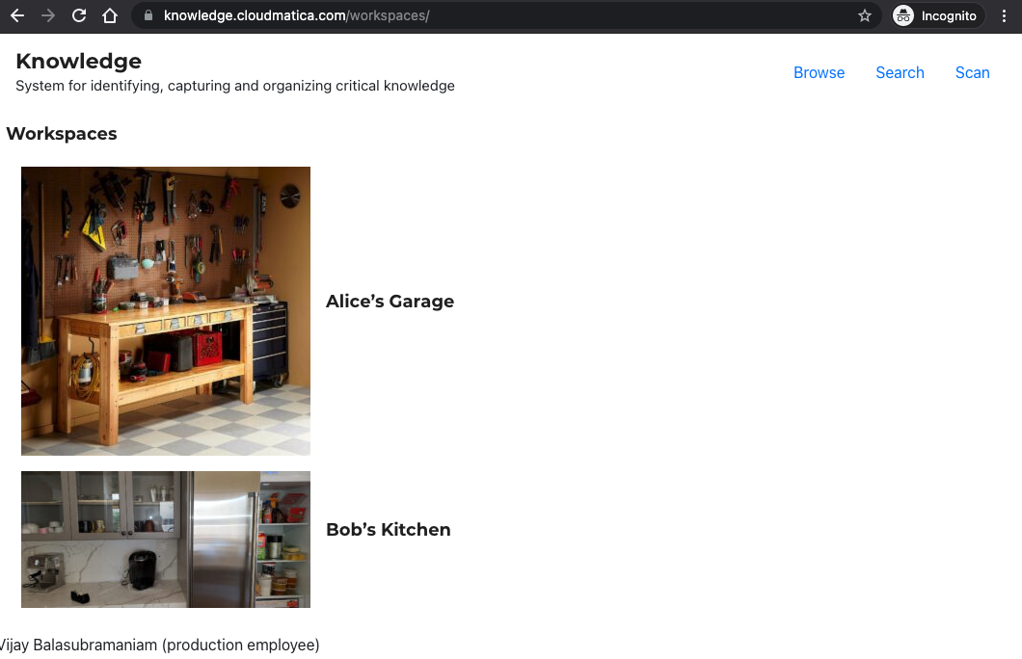

Slide 18
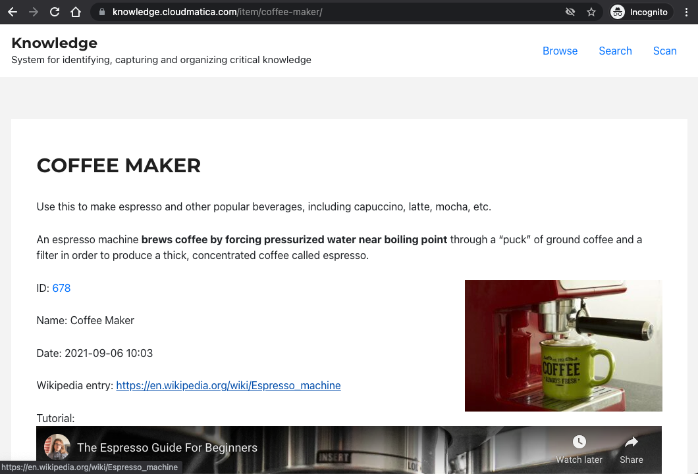

Slide 19
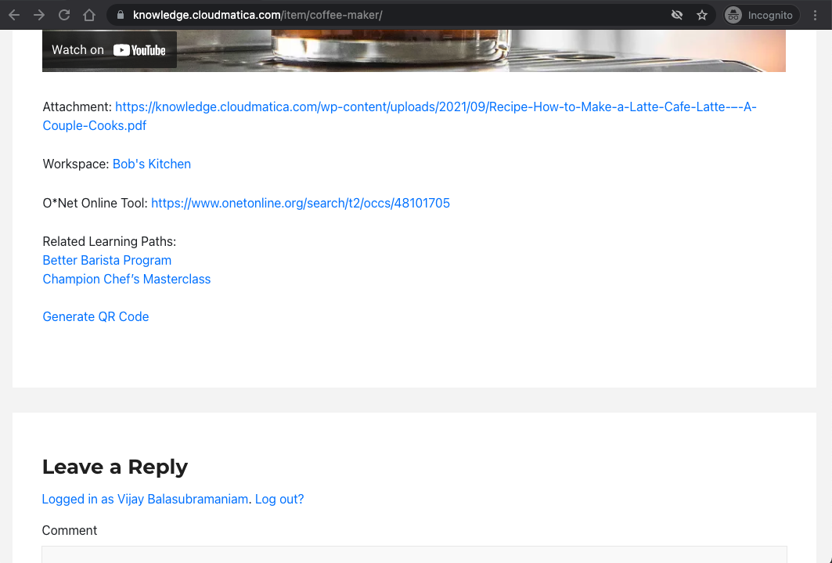

Slide 20
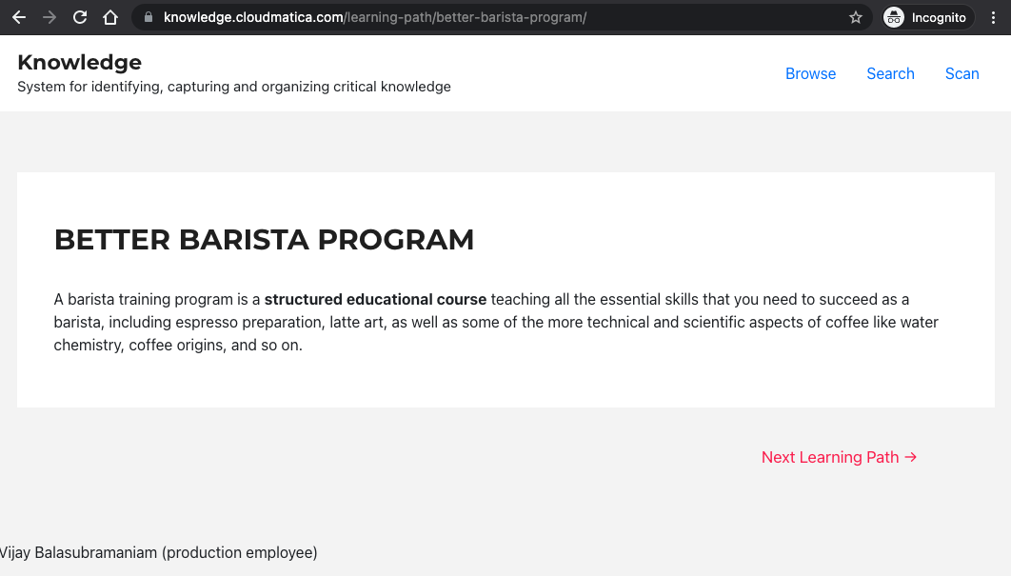

Slide 21
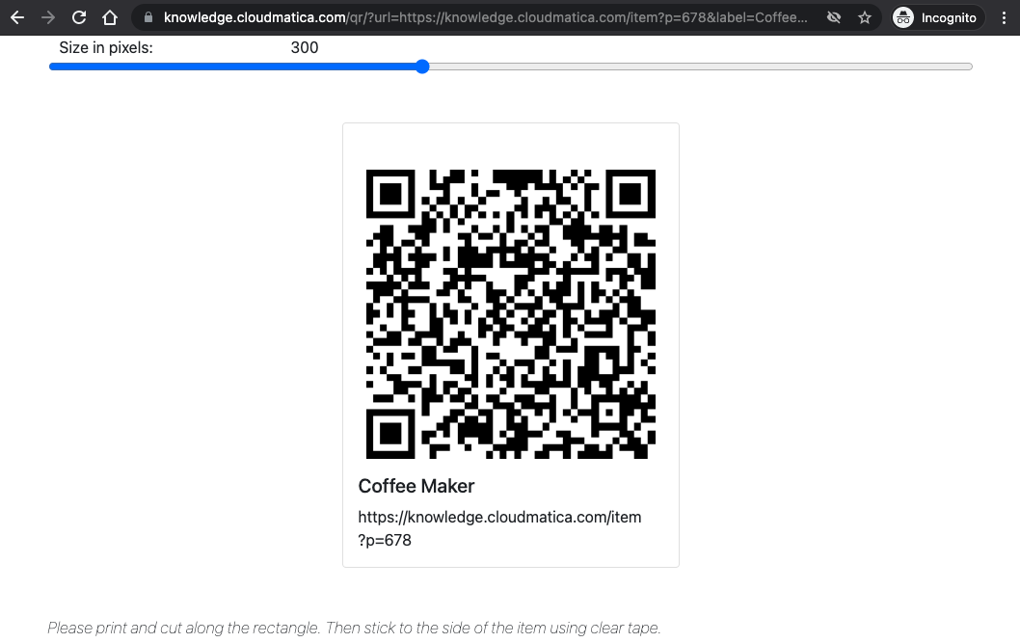

Slide 22
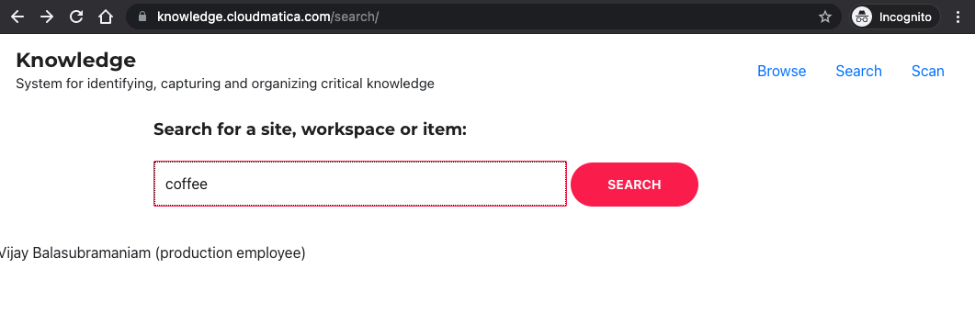

Slide 23
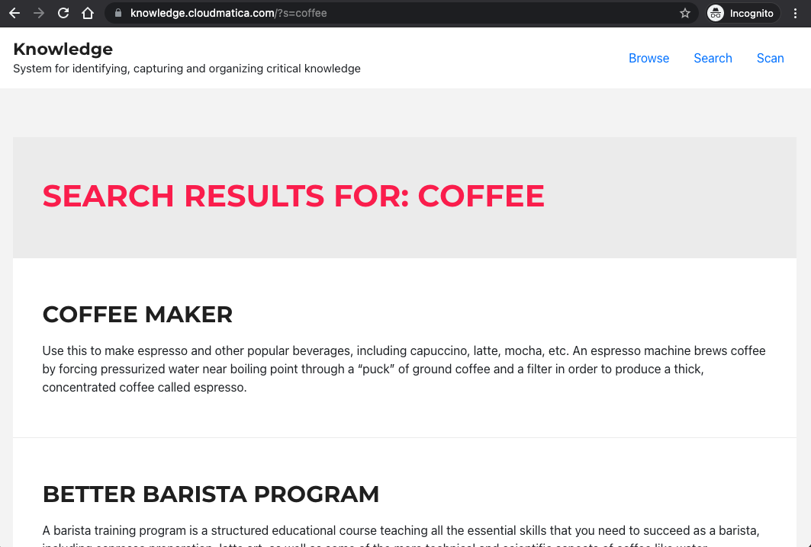

Slide 24
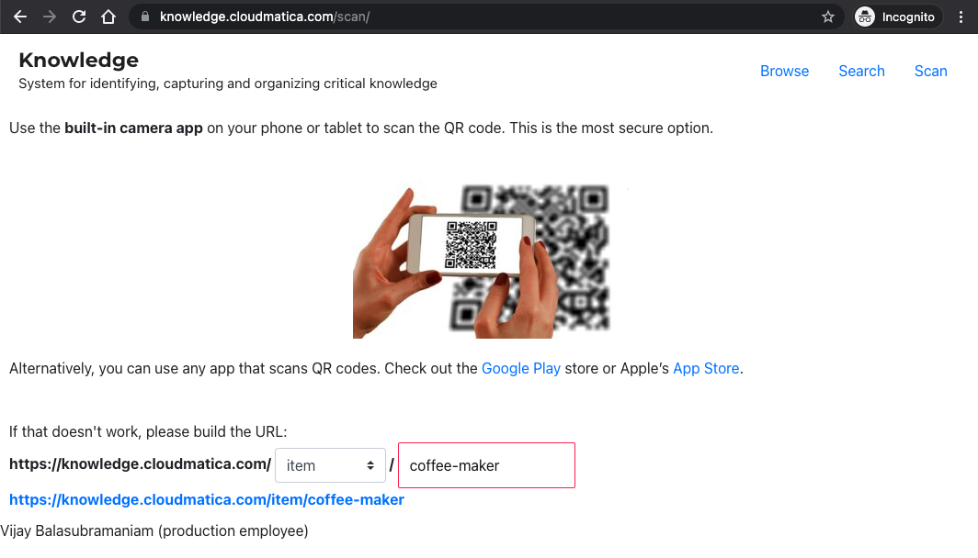

Slide 25
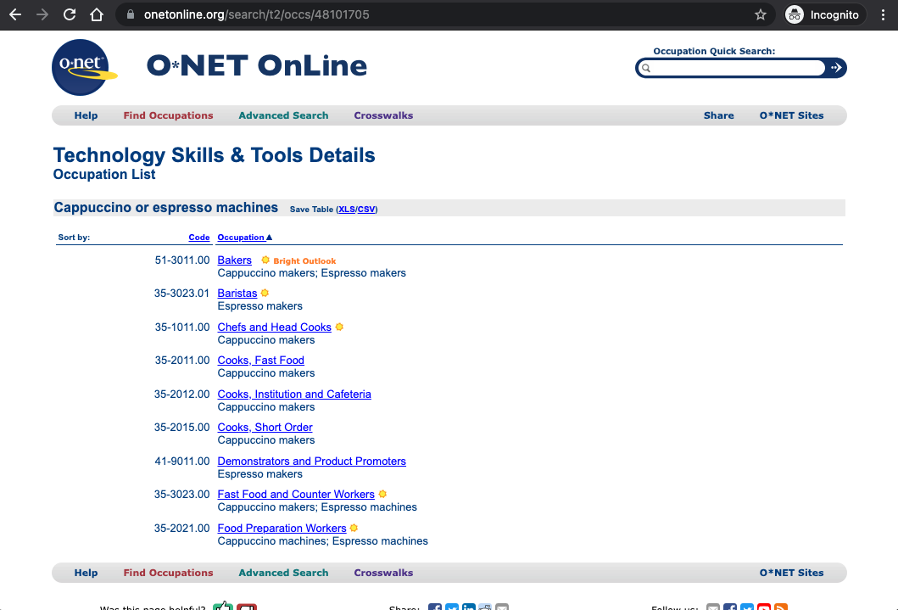

Slide 26
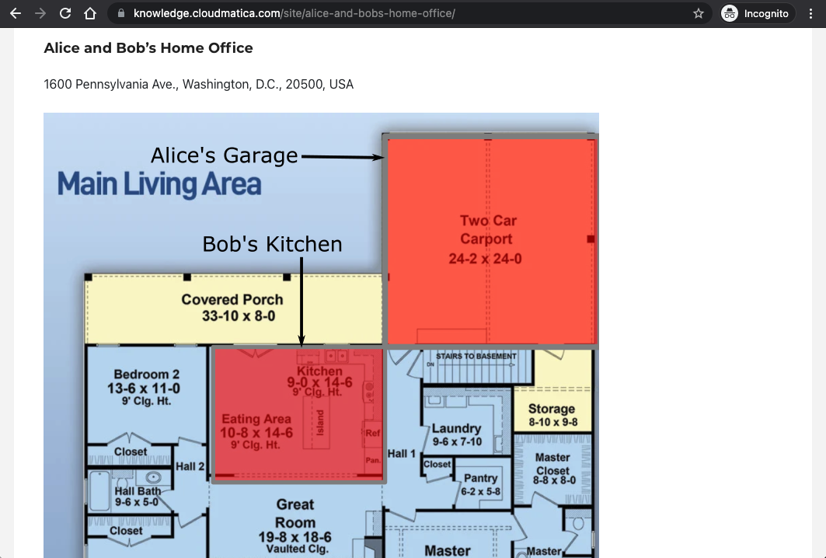

Slide 27
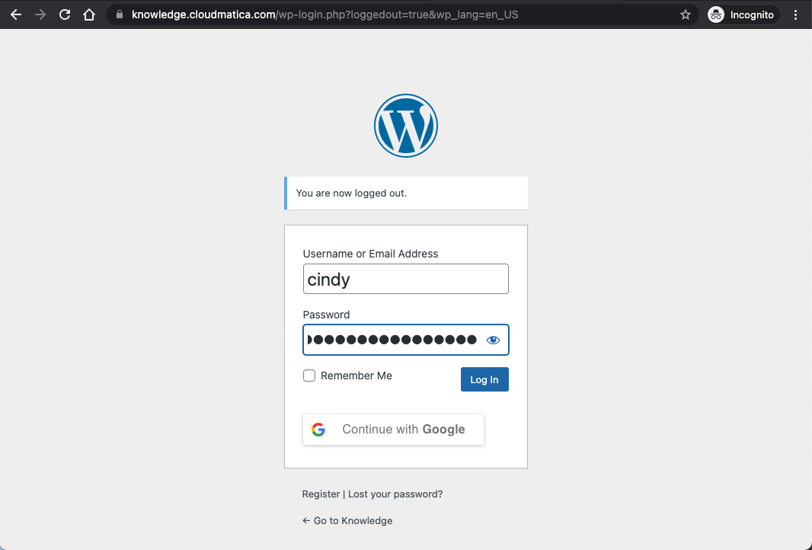

Slide 28
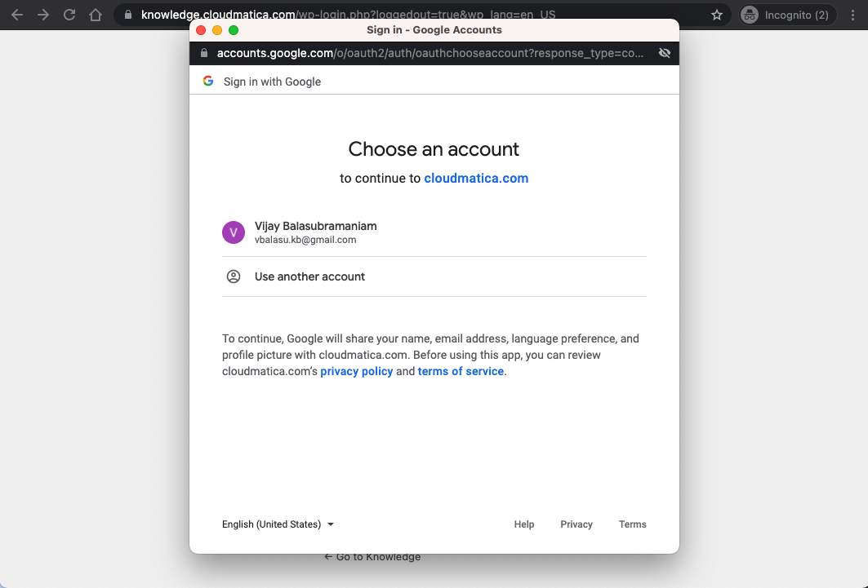

Slide 29
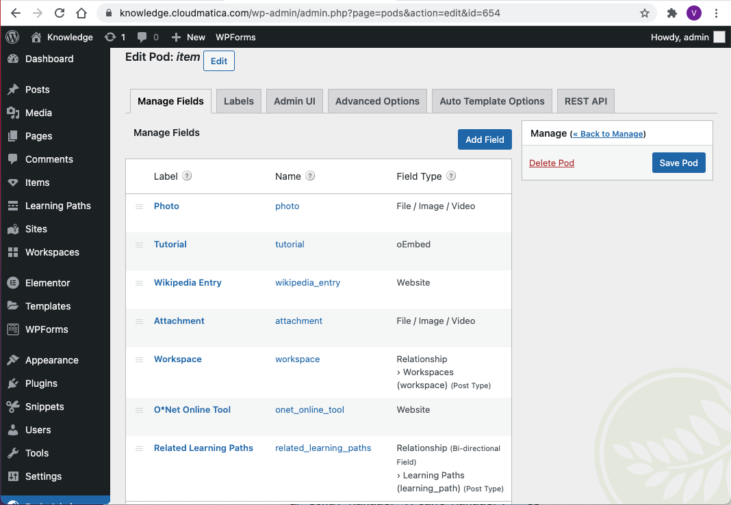

Slide 30
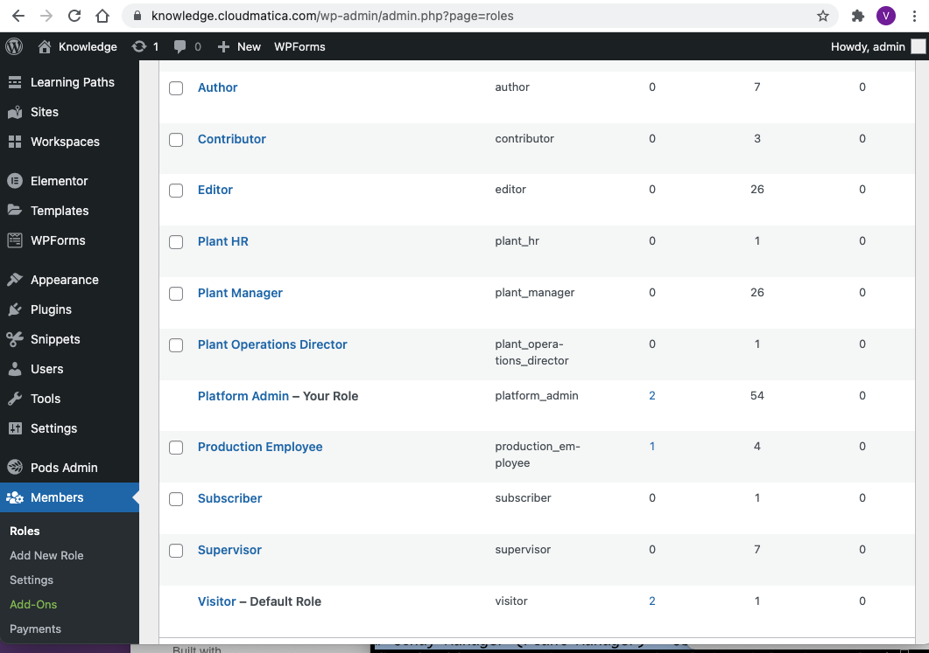

Slide 31
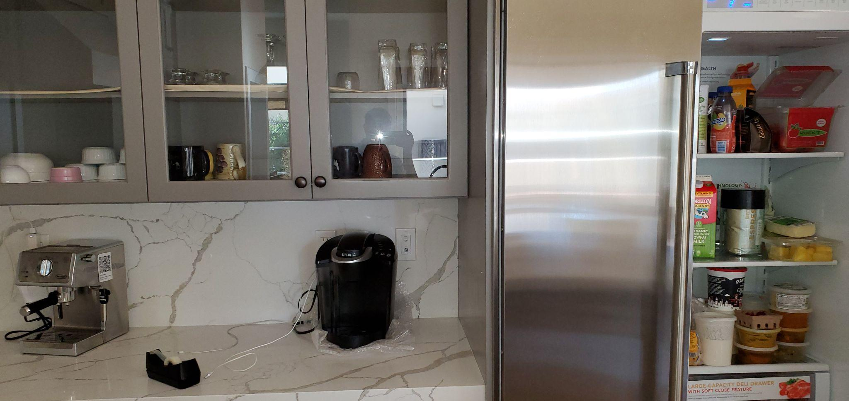
Cups
Ground Coffee Beans
Coffee Maker
Milk

Slide 32
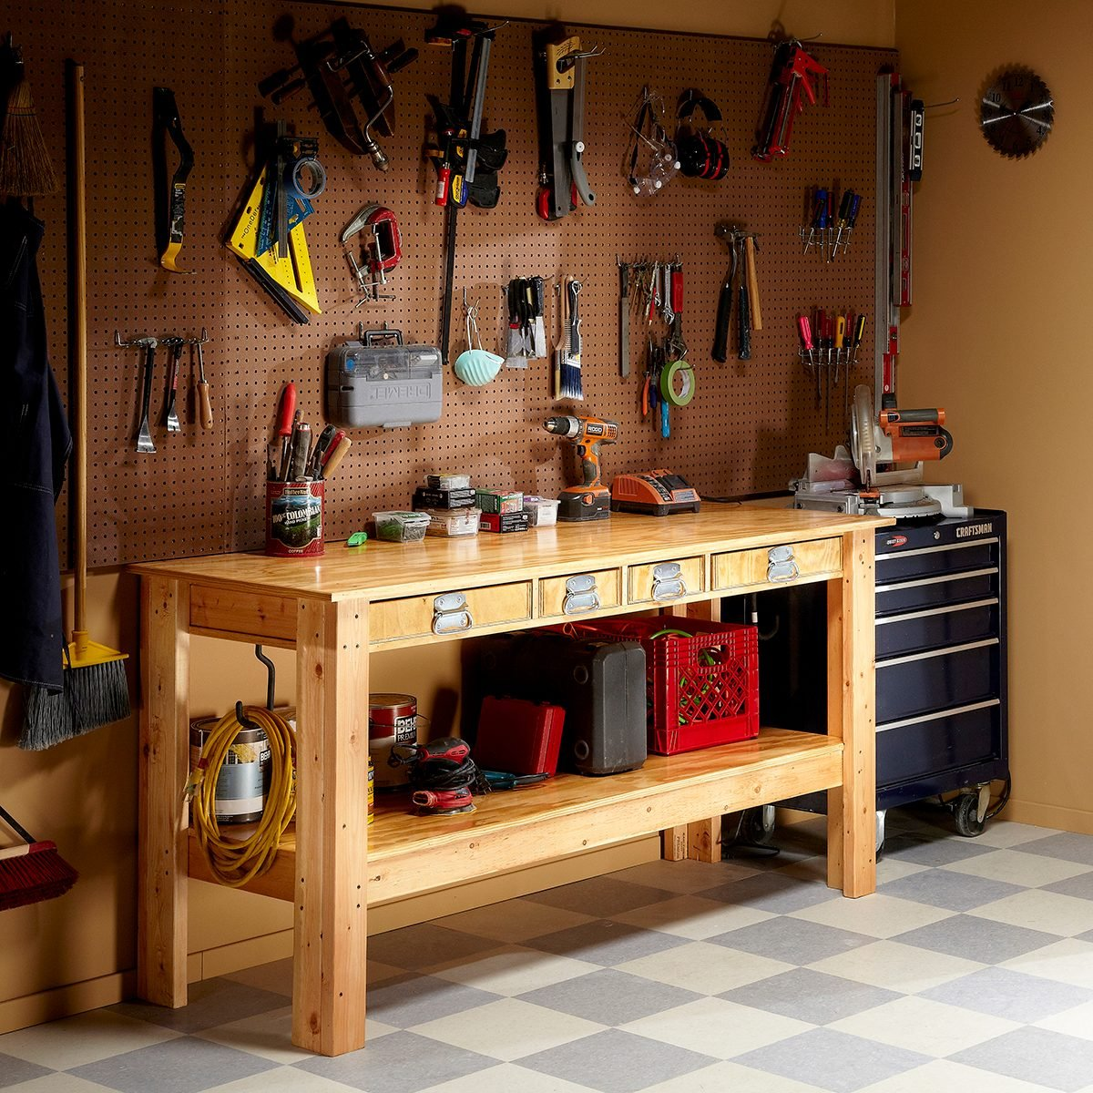
Circular Saw
Screw Clamp
Screw drivers
Power Drill

Slide 33
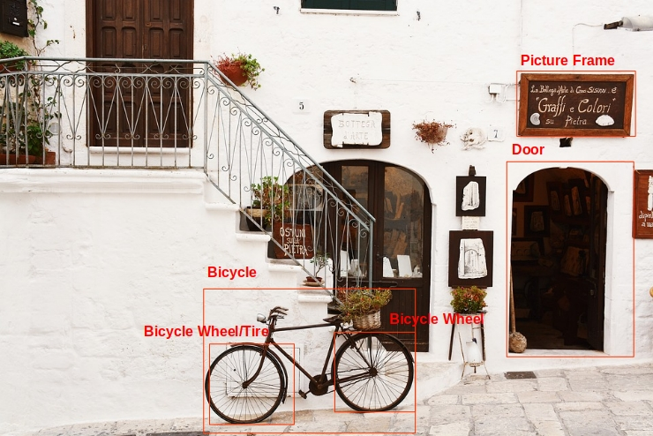

Slide 34
https://knowledge.cloudmatica.com
https://github.com/vbalasu/knowledge
Working Prototype!
Source Code

Slide 35
Thank you!

